Slide 1
Right-Wing Populism in Europe and the United States
A lecture prepared for delivery at Mini University,
Indiana University, Bloomington, Indiana, on June 13, 2017
Jeffrey A. Hart, Emeritus Professor
of Political Science

Slide 2
Definitions
Populism is the quality of appealing to or identifying with ordinary people (not elites)
Right-wing populism is a political ideology that rejects the current political consensus and often combines ethnocentrism, and anti-elitism. It is considered populism because of its appeal to the "common man" as opposed to the elites.
Left-wing populism is a political ideology which combines left-wing politics and populist rhetoric and themes. The rhetoric often consists of anti-elitist sentiments, opposition to the system and speaking for the "common people."

Slide 3
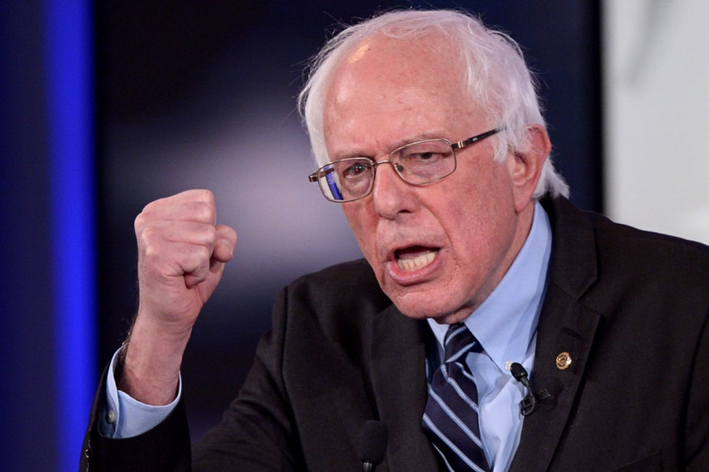
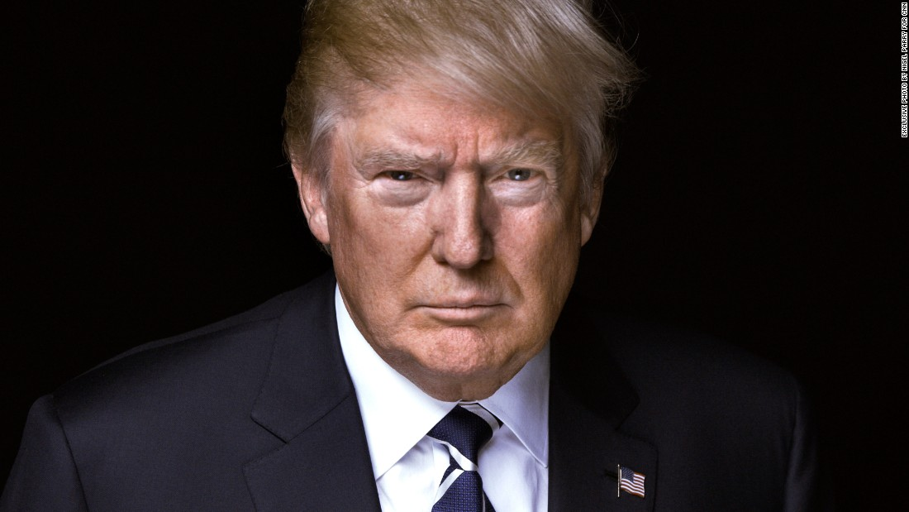
Populism in the USA
Left Wing
Right Wing

Slide 4
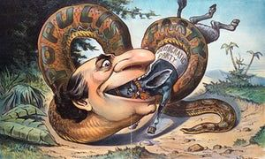
Cas Mudde’s definition
“I define populism as an ideology that considers society to be ultimately separated into two homogeneous and antagonistic groups, ‘the pure people’ versus ‘the corrupt elite’, and which argues that politics should be an expression of the volonté générale (general will) of the people.”

Slide 5
Five Key Ideological Elements
Emphasizing sovereignty of the people
Advocating for the people
Attacking the elites
Ostracizing others
Invoking the heartland

Slide 6
Differences among European Right Wing Populists

Slide 7
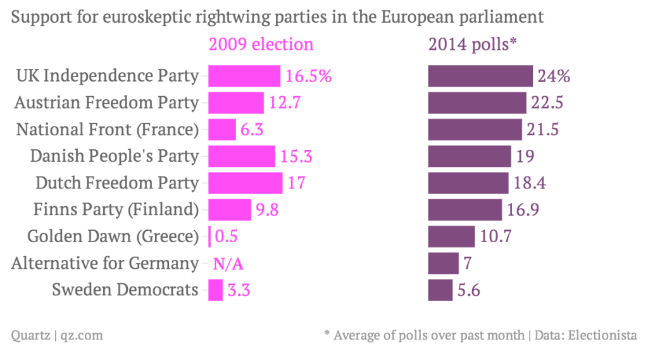
Rise of Rightwing Populist Parties In Western Europe

Slide 8
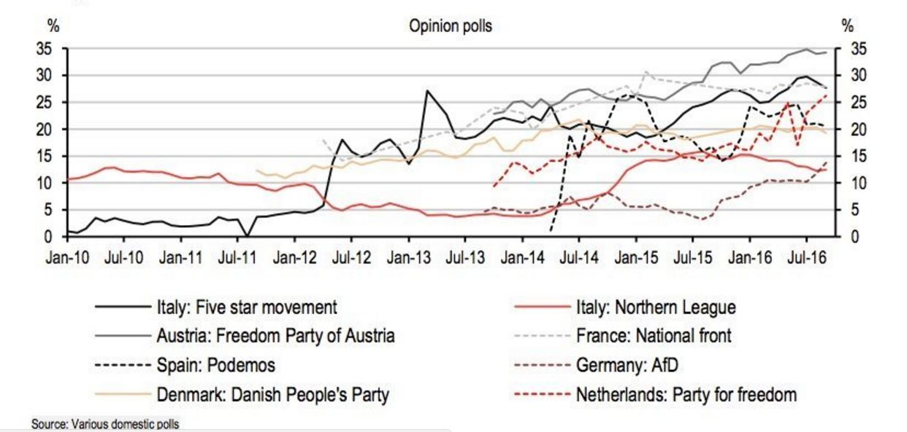
Popularity of West European Populist Parties

Slide 9
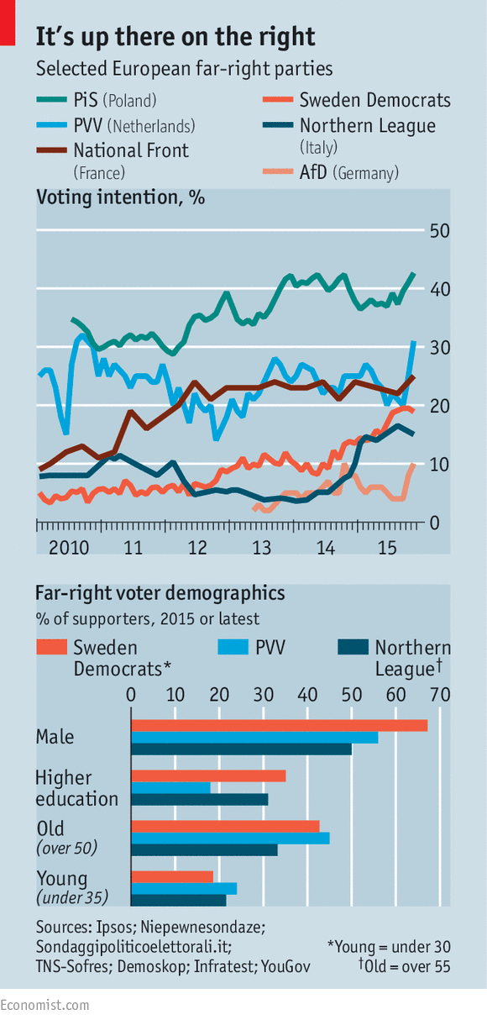
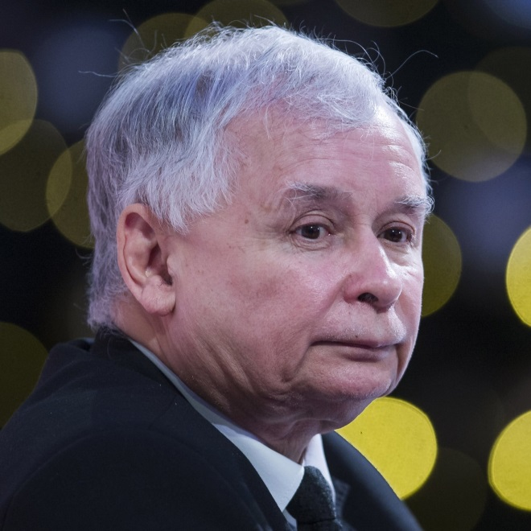
Jaroslaw
Kaczynski
of Polish PiS
Party
France, Poland, and Austria high on right wing voting intentions
Germany and Italy lower but increasing support

Slide 10
Geert Wilders, Dutch PVV
Founder of PVV (Party for Freedom)
Strongly Anti-Islam
Favors tax on “head rags”
Keeps his distance from fascists and neo-fascists
Convicted of inciting discrimination against Moroccans
PVV gained seats in 2017

Slide 11
Matteo Salvini, Northern League in Italy
Head of Lega Nord since 2013
Member of European Parliament
Euroskeptic and strongly opposes illegal immigration
Supports Padania (separation of Northern from Southern Italy)

Slide 12
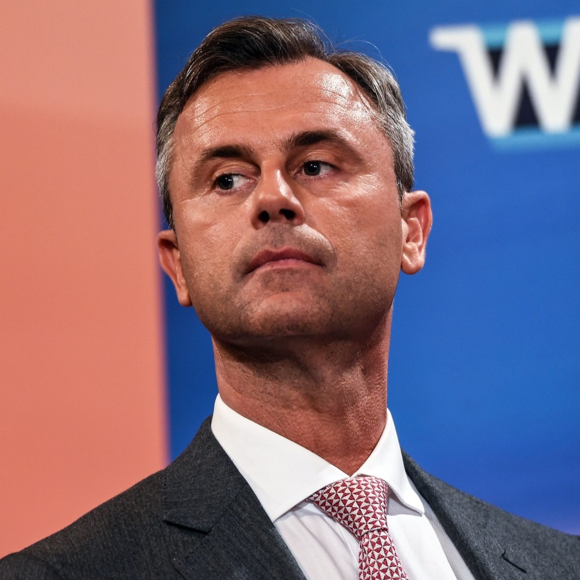
Norbert Hofer, Austrian Freedom Party
Narrowly lost 2016 Election for President
Received 47 percent of votes in second round
Opposes immigration, free trade, globalization

Slide 13
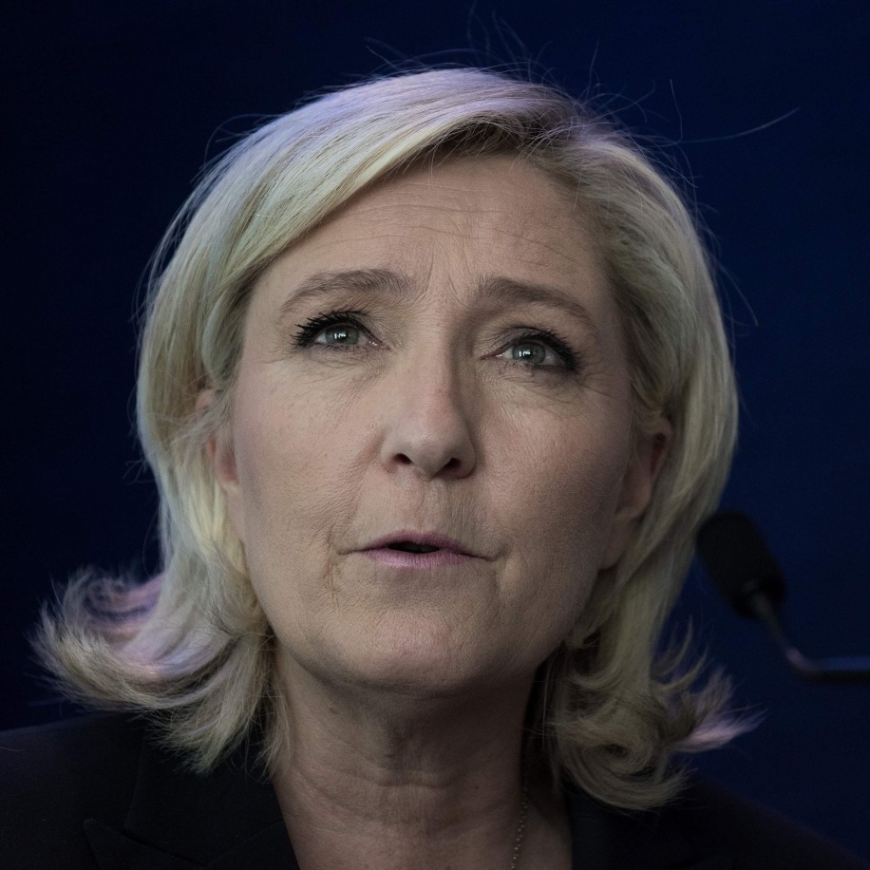
Marine Le Pen and the National Front in France
Took over leadership of National Front from her father
Tried to make the party more acceptable to voters by expelling racist and anti-semitic members
Won 34 percent of the vote for President in 2017

Slide 14
Nigel Farage, UKIP in Britain
Led UKIP 2010-2016
Big role in Brexit vote
Big admirer of Donald Trump and Steve Bannon
Supported Marine Le Pen
Currently works for Fox News

Slide 15
Frauke Petry, Alternative for Germany
Chairwoman of party since 2015
Anti-Muslim, wants to ban minarets
Opposes Sharia law
Opposes existing immigration practices

Slide 16
Is Populism Fascism?

Slide 17
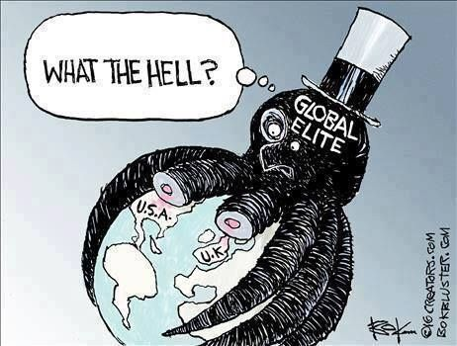
Notable Recent Elections
Brexit vote in June 2016
Election of Donald Trump in November 2016
PVV wins seats in Netherlands parliament 2017
Victory of Macron over Le Pen in France in 2017

Slide 18
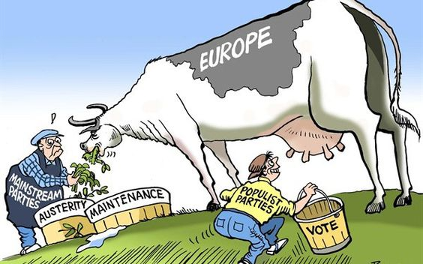
Factors that explain the rise of populism (right and left)
Slow economic growth
Dissatisfaction with democratic institutions
Low social mobility and high inequality
Anti-globalization sentiments
Rise in immigration rates and the flow of refugees
Support from Russia

Slide 19
Causes of Sluggish Growth
Major contraction following the financial crisis of 2007-8
Major increases in deficit spending financed by public debt to maintain pre-crisis levels of growth and employment
Increased debt leads to increased interest rates in weaker economies
Adoption of austerity policies to deal with budget shortfalls
Delayed restructuring of sectors that continue to drag down the overall economy

Slide 20
The European Refugee Crisis
Began in 2015
Rising numbers seeking asylum: espec. Syrians, Afghanis, and Iraqis
Largest number of asylum application in Germany but large numbers of asylum seekers in Greece and Turkey
Turkey has 2 million Syrian refugees now
EU-Turkey deal in March 2016 to send Greek asylum seekers to Turkey in exchange for a big aid package and accelerated negotiations for membership in the EU

Slide 21
Factors that Influence Anti-Immigration Attitudes
Unemployment
Low socio-economic status (espec. Education)
Low-skill employment
Youth

Slide 22
“Supply-Side” Factors
Multiparty electoral systems
Proportional Representation
Convergence of Mainstream Parties

Slide 23
Conclusions
In Europe, supporters of Right-Wing Populist Parties are anti-immigrant and anti-EU
Anti-Islamic views are prevalent among both leaders and followers
Until recently, these parties had too few voters to form their own governments or to elect heads of state
Anti-elitist, ethnocentric, anti-democratic elements are worrisome for the future of democracy
If the European economy improves, however, the danger will decrease

