Slide 1
INTERNATIONAL Politics in the Age of the Internet
Jeffrey A. Hart
Lecture prepared for delivery at Mini University,
Indiana University, Bloomington, June 11, 2014.

Slide 2
About me
Professor Emeritus of Political Science
Taught at IU from 1981 to 2013
Specialist in International Relations and International Political Economy
Web site: http://mypage.iu.edu/~hartj
You can access this lecture at: http://www.slideshare.net/hartjeff12/

Slide 3
What is the Internet?
Technically: a network of networks that operates under the TCP/IP protocols
More broadly: a set of information and computing technologies (ICTs) that are associated with the Internet
Even more broadly: the economic, social, cultural, and political cyberspaces occupied by users of the Internet

Slide 4
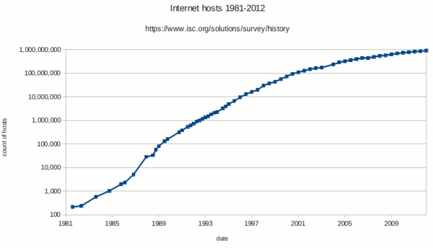
Internet Hosts, 1981-2012

Slide 5
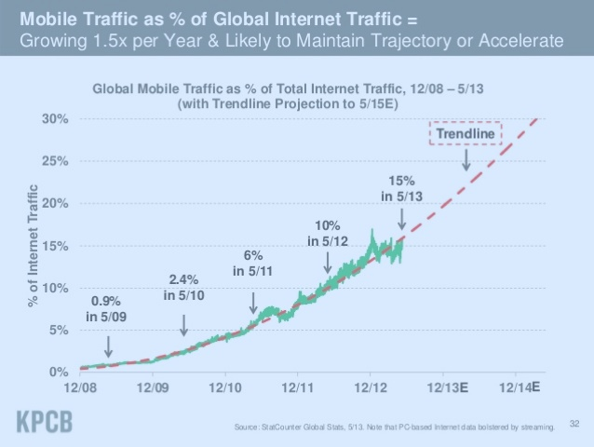
Wired vs. Wireless Access

Slide 6
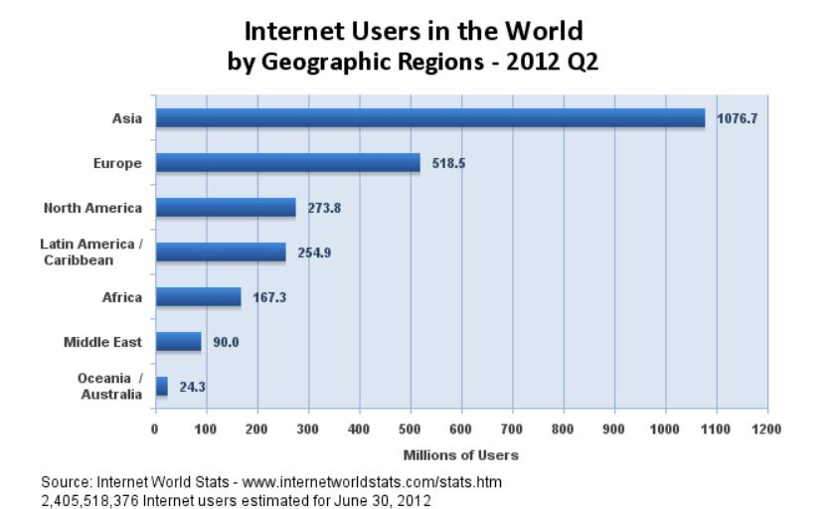
Internet Users by Region

Slide 7
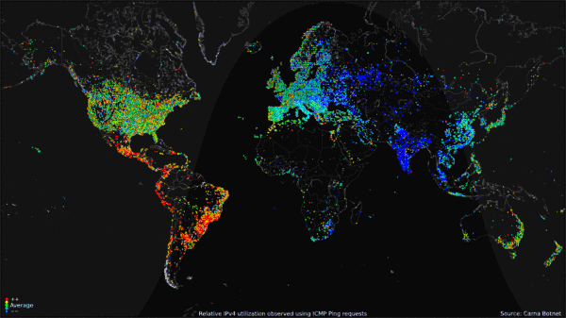
World Map of Usage over a 24 Hour Period in 2012: Red is High

Slide 8
What has changed?
Faster and cheaper communications that are increasingly global in scope
Much lower barriers to forming groups, especially groups that connect geographically dispersed people and institutions
New forms of collaboration
The migration of many human activities that used to occur only in the physical world to “Cyberspace”

Slide 9
How does this affect international politics?
Giving individuals and other non-state actors greater ability to organize and express their views in domestic politics (e.g. the Arab Spring)
Bringing greater transparency to a variety of economic, social, and political institutions (e.g. the rise of blogs, YouTube, WikiLeaks, and Edward Snowden)
Allowing governments (and others) to better monitor the activities of their citizens (surveillance)
Cyber warfare and Cyber security

Slide 10
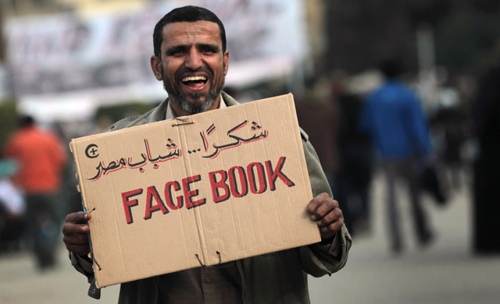
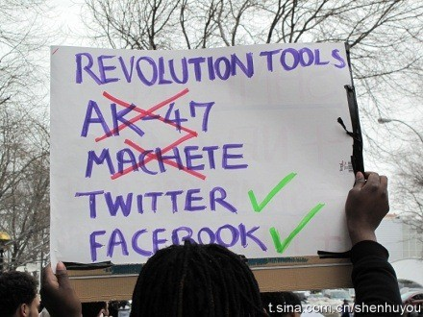
Role of Social Media in the Arab Spring?

Slide 11
Transparency
In theory, greater transparency is necessary for preserving democratic institutions
Many democratic governments have pursued this by putting information online and permitting citizen input online
Limits to the above exist because of national security and individual privacy concerns

Slide 12
Examples of Government Surveillance
National Security Agency (NSA) massive collection of Internet data
Chinese government authorized hacking of industrial data along with filtering of content that Chinese citizens can access
Storage of videos from closed-circuit video cameras (US, UK, Russia, China, etc.)
Access of governments to private data warehouses (phone companies, Google, etc.)

Slide 13
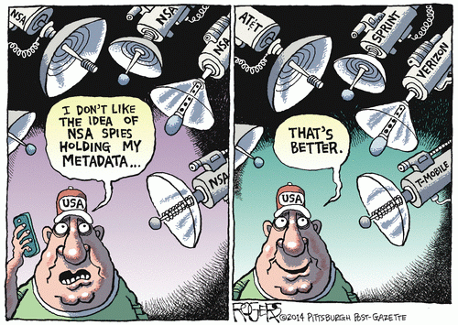
Recent Decision to Tell NSA not to directly access data

Slide 14
Examples of Cyber warfare
2007 Russian cyber attacks on Estonia
2008 Wars in Georgia, South Ossetia involved cyber attacks, mainly by civilians but possibly with government involvement
US Department of Defense sets up Cyber Command in 2010
President Obama authorizes cyber attack on Iranian nuclear facilities (Stuxnet worm)

Slide 15
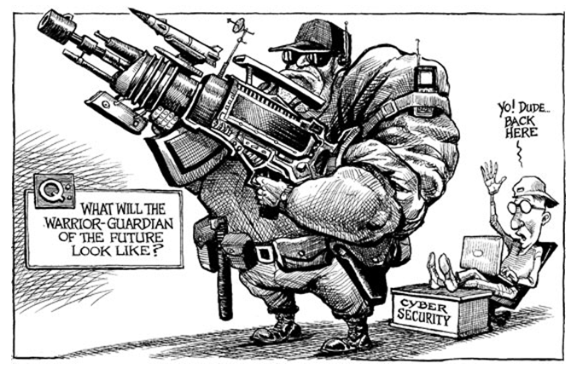
Future Warriors

Slide 16
Hillary Clinton’s Internet Freedom Speech
Internet Freedom Speech by Hillary Clinton in January 2010
“The spread of information networks is forming a new nervous system for our planet.”
“…information has never been so free.”
“…these technologies are not an unmitigated blessing. These tools are being exploited to undermine human progress and political rights.”
“By relying on mobile phones, mapping applications, and other new tools, we can empower citizens and leverage our traditional diplomacy.”

Slide 17
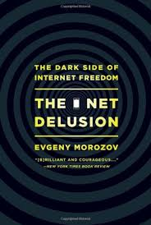
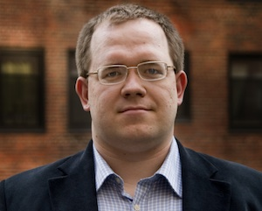
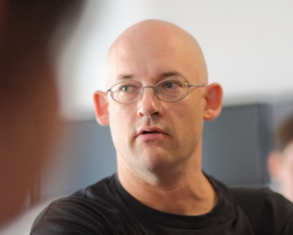
Suggested Readings
Clay Shirky, Here Comes Everybody
Evgeny Morozov, The Net Delusion

Slide 18
Key ideas in Clay Shirky’s Work
Collaborative crowd-sourced work results from "a successful fusion of a plausible promise, an effective tool, and an acceptable bargain with the users.“
Examples: Facebook, Wikipedia, Flickr, eBay, and Angie’s List
Sharing can result in effective collective action (e.g. the Arab Spring)

Slide 19
Key Ideas in Evgeny Morozov’s Work
Skeptical about the ability of the Internet to undermine authoritarian regimes
Emphasizes the possibility of using the Internet for mass surveillance and undermining civil liberties
Opposes “cyber-utopianism” and “solutionism” where all problems can be solved by insuring access to the Internet

Slide 20
What do you think?
Tell us about your own experiences with the Internet and the World Wide Web.
What do you think can be done to mitigate the evil effects of the new technologies and make it more likely that individuals will be empowered rather than disempowered?

