Slide 1
THEORIES of International Relations
Jeffrey A. Hart
Professor
Department of Political Science
Indiana University
September 23, 2009

Slide 2
Overview
The Classical Authors
Macchiavelli
The Rise of the Nation-State System
Thinkers of the Post-Westphalian Period
Diplomatic History
American Idealism
American Realism and Neo-Realism
Integration, Interdependence, and Regimes

Slide 3
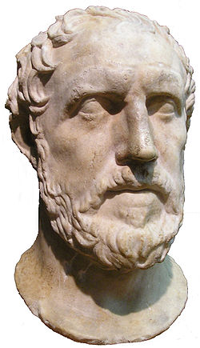
Thucydides
The Peloponnesian War, 431-404 B.C.
Bipolar distribution of power:
Athens and its allies
Sparta and its allies
External threat from the Persian Empire
He criticized Athens for over committing its resources when it invaded Sicily

Slide 4
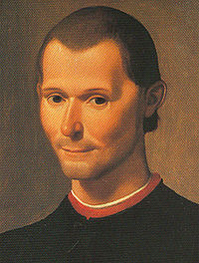
Macchiavelli
Major works:
The Prince (1513)
The Art of War (1521)
First author to distinguish between morality of individuals and morality of the state
Ended his life in exile in Tuscany

Slide 5
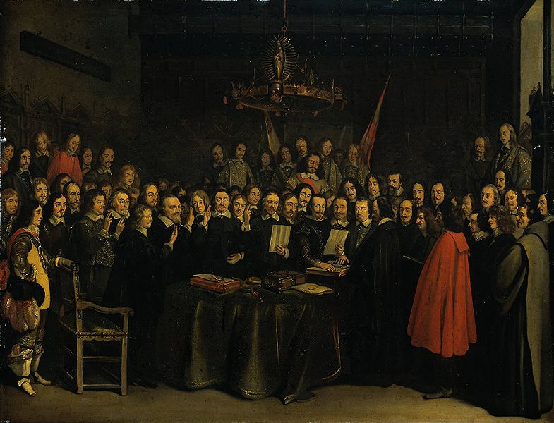
The Rise of the Nation-State System
The Peace of Westphalia in 1648 marked the beginning of the nation-state system in Western Europe.
After extensive fighting over religious questions, the signers of the peace treaty agree to a new order based on the concept of state sovereignty, more specifically the right of each state to choose its own religious preferences.
Gerard ter Borch painting of
the ratification of the Treaty
of Muenster

Slide 6
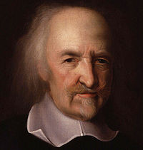
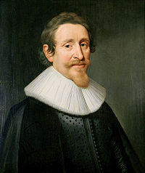
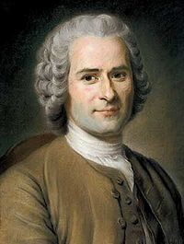
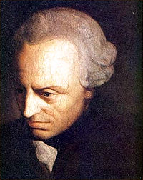
Thinkers of the Post-Westphalian Period
John Hobbes
Hugo Grotius
Jean Jacques Rousseau
Immanuel Kant

Slide 7
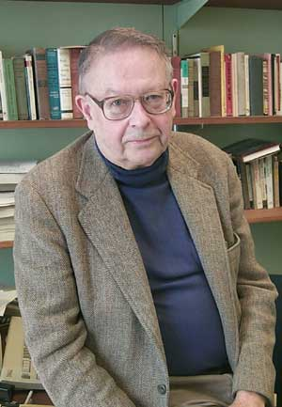
One Interpretation: Kenneth Waltz’s Man the State and War
Three images (concerning the real origin of war):
Human nature (Hobbes, Locke)
Regime type
International system (Rousseau)
Waltz argues that the third image is superior to the other two.

Slide 8
The Diplomatic Historians
Rose to prominence in the 19th century
Focused on detailed description of diplomacy and statecraft among the European great powers after 1648
Stressed the importance of individual leaders and their ability to create and maintain coalitions
Influential writers: Leopold von Ranke, William Langer, Ludwig Dehio, F.H. Hinsley

Slide 9
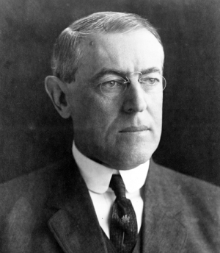
American Idealism
Strongest advocates of the use of international law to prevent war were in the United States.
Woodrow Wilson pushed strongly for the creation of the League of Nations after WW1 only to see it rejected by Congress.
In the 1920s and 1930s, many Americans supported diplomacy and other alternatives to warfare, and wanted to avoid involvement in another European conflict.

Slide 10
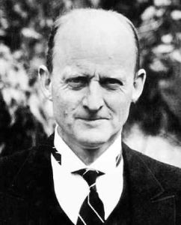
Post-War Realism
Key Authors
E.H. Carr
Reinhold Niebuhr
Hans Morgenthau
John Herz
Hedley Bull
Criticized the idealism of earlier thinkers; emphasized the primacy of the pursuit of power in international affairs

Slide 11
The Debates over Polarity
Some realist scholars thought that a multipolar system (which they posited existed in Europe in the 18th and 19th centuries) was more stable and less likely to result in another global war than the bipolar system that came into existence with the end of WW2.
Others (including Kenneth Waltz) argued that bipolarity was better.
A number of major books and articles were published on this question.

Slide 12
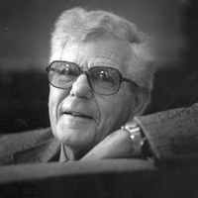
Integration, Interdependence, and Regime Theories
Scholars in this area were looking for pragmatic ways to build up international institutions and legal regimes in ways that might prevent future wars, but would also lead to greater economic prosperity.
They started by looking at the political support for European integration.
Key authors included: Ernst B. Haas, Leon Lindberg, Stuart Scheingold, Philippe Schmitter, Joseph Nye.

Slide 13
The Rise of International Political Economy
After the oil price increases in the 1970s, even hard-boiled realists like Henry Kissinger realized the importance of economic factors in world affairs.
The idea of “managing interdependence” came into vogue.
While the originators of the idea of interdependence were looking for new sources of order in the system, some realists were retooling to include economic relationships in their theories.

Slide 14
Neo-Realism
One reaction to theories of interdependence and international regimes was to return to the earlier ideas of the post-WW2 realists.
A key figure in this revival was Kenneth Waltz and his main contribution was Theory of International Politics (1979).
Waltz argued for the key importance of the distribution of power in the international system because there was no real order other than a state of “anarchy” in that system in which states had to defend themselves.

Slide 15
Robert Keohane and Neo-Realism
Keohane tried to reconcile the neo-realist focus on power and the distribution of power with the IPE schools focus on regimes and regime change.
His answer was to suggest a connection between the distribution of power and regime changes (building on the work of earlier scholars like Charles Kindleberger, John Ruggie, Stephen Krasner, and Robert Gilpin).
Thus was Hegemonial Stability Theory (HST) born.

Slide 16
Other Isms
Constructivism
Post-Modernism
Neo-Marxism
Feminism

Slide 17
Summing Up
Theories of international relations have evolved in ways that are somewhat different from those in other disciplines: more faddish, less driven by empirical research.
While there is some continuity in their focus on war and peace and the distribution of power, in the last century the gap between those scholars looking only at military-strategic issues and those looking at a broader range of phenomena has grown significantly.

