Slide 1
Revising Theories of International Politics in the Information Age
Jeffrey A. Hart
Indiana University
Paper presented at the annual meeting of the International Studies
Association, San Diego, California, April 1-4, 2012,

Slide 2
Six Approaches/Perspectives in IR Theory
Realism and Neo-Realism
Liberal Institutionalism
Theories of Globalization
Long Wave/Cycle Theories
Marxist and Neo-Marxist Approaches
Constructivism

Slide 3
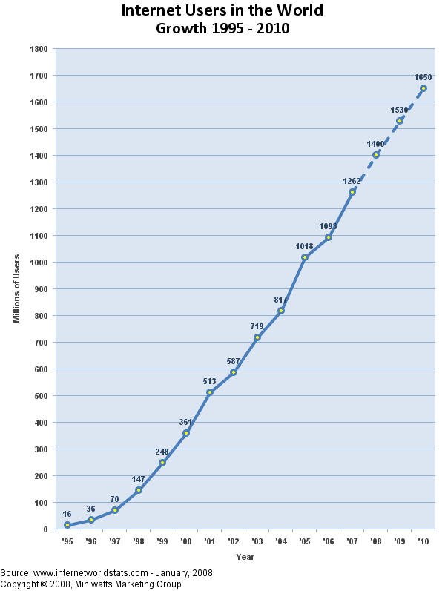

Slide 4
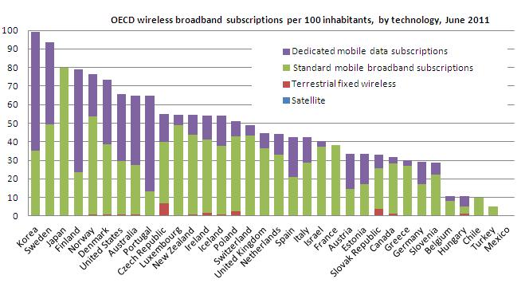
Broadband Penetration

Slide 5
Challenges to Realism and Neo-Realism
The primacy of the state (effectively the governments of nation-states) vs. the increased power of non-state actors
Focus on capabilities and relational power
Dealing with Cyberwar and Cybersecurity within the old framework
Continuing difficulties associated with superficial attention to the role of technological change and other forms of social and economic change

Slide 6
Neoliberal Institutionalism
New ICT-related regimes
New push for multi-stakeholder regimes
Do ICTs make MNCs and NGOs more powerful relative to governments?
New opportunities for studying ICT-based monitoring of regime compliance
Need to understand how ICTs affect the diffusion of liberal norms and practices

Slide 7
Theories of Globalization
Inherently global natures of the Internet vs. Success of various governments in limiting access
Effect of ICTs on communications and transactions costs
Rise of global production networks and big box retailing (undermining national production and retailing networks)
Impact of ICTs on diasporic communities, journalism and media environments

Slide 8
Long Wave/Cycle Theories
How does the wave of innovation associated with ICTs resemble or differ from previous waves of innovation?
Network economies vs. economies of scale
Has the ICT wave crested? (Is a Bio-Tech, Nano-Tech, or Enviro-Tech wave beginning?)
Who are the new winners and losers (nationally and sub-nationally)?

Slide 9
Marxist and Neo-marxist approaches
Is there new Mode of Production or Mode of Information (Poster)?
How is “consumer capitalism” altered?
Are ICTs simply a manifestation of the reassertion of US-dominated (capitalist) global imperialism/hegemony?
Is political opposition to globalization via ICT-mediated communication the way to keep the Left alive and relevant?

Slide 10
Constructivism
Many flavors of constructivism
ICTs and ICT-related regimes are socially constructed (human agency)
ICTs permit the fostering of new meanings and identities for individuals and social group
Potentially transformative nature of ICTs in domestic and international politics vs. the tendency of power structures to adapt successfully to technological change

Slide 11
Power Revised
New forms of capability (access to resources) with the diffusion of ICTs
New ways of exercising power: e.g., through the creation and control of new technological infrastructures and platforms (the PC, iTunes, Facebook, etc.)
Structural power (most relevant to IPE) in the form of new regimes and regimes imbedded in hardware/software (as argued by Lessig and others)
Meta-power

Slide 12
Conclusions
New forms of power associated with the diffusion of ICTs
Key aspect of ICTs: reduction of the role of distance and cost in communications among like-minded people and groups
All IR theories need to address the above and to study continuing barriers to flows of information/knowledge
Realism seems least likely to take diffusion of ICTs seriously

