Slide 1
The Politics of File Sharing in the United States
Jeffrey A. Hart
Professor
Department of Political Science
Indiana University
http:\mypage.iu.edu\~hartj
The Rise and Fall of SOPA and PIPA

Slide 2
Sequence of Events
PIPA (S. 969) introduced May 2011
SOPA (H.R. 3261) introduced October 2011
Copyright holders and their allies support the two bills
Internet companies and their allies oppose them
President Obama expresses opposition
Bills are shelved (mid January 2012)

Slide 3
Purpose of the Research
To explain the shelving of the bills given the initially strong bipartisan support for them
To examine the role of financial contributions to Senators and Representative
To analyze claims about the mobilization of opponents by Internet companies via the Internet (the Nerd Spring hypothesis)
To place these events into a broader interpretive and theoretical context

Slide 4
History of Copyright Act
1790 | Congress passes copyright act
1830 | Act expanded to published music
1856 | Act extended to published plays
1870 | Act extended to works of art. Library of Congress become clearing house.
1897 | Act extended to public performances
1909 | Act extended to reproductions (piano rolls)
1912 | Motion pictures added
1976 | Sound recordings and unpublished works
1980 | Computer programs
1988 | Copyright Term Extension Act

Slide 5
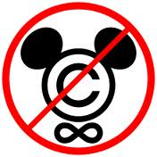
Copyright Term Extension Act of 1988
The Copyright Act of 1976 set the term of copy as the life of the author plus 50 years for individuals and for the life of the author plus 70 years for corporations or 95 years after publication.
The Copyright Term Extension Act of 1988 (sponsored by Sonny Bono) extended copyright terms in the US by 20 years to 95 years after publication.
Also called “The Mickey Mouse Protection Act.”
Rep. Sonny Bono (of Sonny and Cher fame)

Slide 6
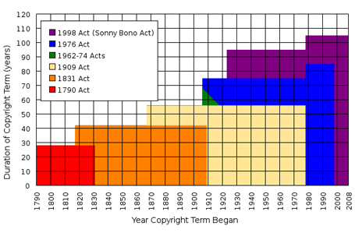
Increasing Length of Copyrights

Slide 7
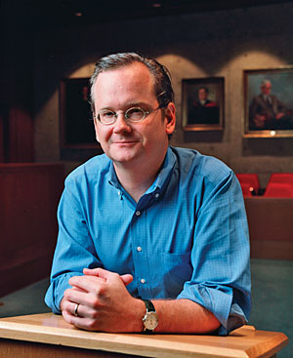
Increased Focus on Protecting Intellectual Property
RIAA, MPAA attacks on file sharing
Counterarguments by scholars about the negative aspects of overly ambitious “digital rights management”

Slide 8
More Recent Intellectual Property Rights Legislation
Digital Millennium Copyright Act (DMCA) of 1998 (safe harbor provisions connected with notice and takedown practices)
Inducing Infringement of Copyrights Act of 2004 reflects the U.S. Supreme Court Betamax decision establishing the criterion of “fair use” and the idea that technologies should not be banned if there are significant non-infringing uses (SNIU) – tightens previous laws

Slide 9
Napster shuts down
In November 1999, the RIAA filed suit against Napster for copyright infringement.
By 2001, Napster had 26.4 Million users.
The RIAA’s suit was successful and Napster had to close down in July 2001.
People interested in sharing copyrighted material turned to gnutella networks and then to BitTorrents

Slide 10
The Pirate Bay and the Pirate Party
2006 Seizure of The Pirate Bay servers by Swedish police.
The Pirate Party was founded in Sweden in 2006. It has become a model for the global International Pirate Movement. The party’s main goal is to reform patent and copyright laws.
Founders of The Pirate Bay in Sweden found guilty of inducing the infringement of copyrights and sentenced to serve prison terms in 2009.

Slide 11
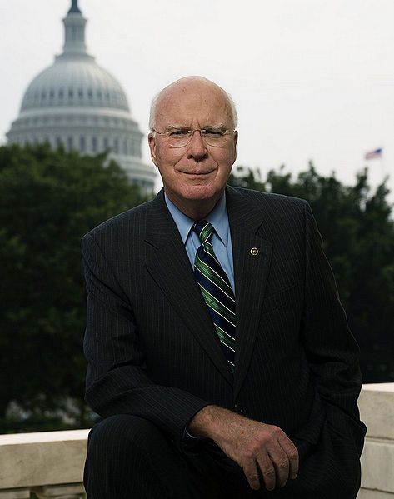
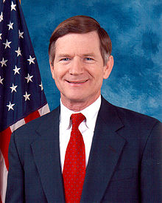
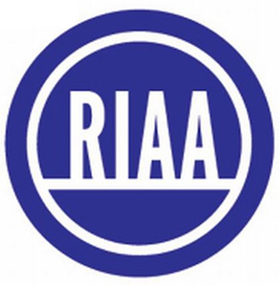
Supporters
Chris Dodd (former Senator (D-CT)
Reprentative
Lamar Smith
(R-TX)
Senator
Patrick Leahy
(D-VT)

Slide 12
Arguments by Supporters
File sharing of copyrighted content constitutes theft or piracy and is therefore illegal.
Illegal file sharing (piracy) is extremely damaging not just to the copyright holders but to the economy as a whole.
Current laws have reduced illegal file sharing in the United States but not in many foreign countries.
There are still U.S.-based companies and organizations that facilitate illegal file sharing activities.
Since the U.S. government does not have jurisdiction over foreign web operators, it must use its jurisdiction over U.S. web operators to stop illegal file sharing abroad.
SOPA/PIPA have adequate safeguards to prevent the possible negative effects of the legislation on U.S. firms and the U.S. economy.

Slide 13
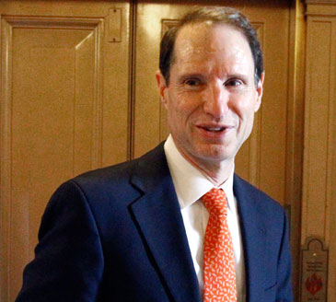
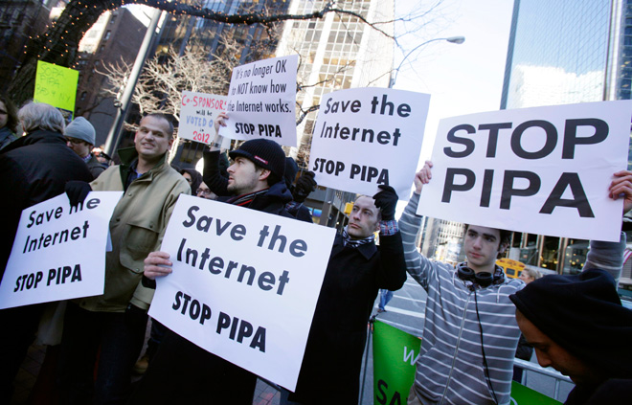
Opponents
Senator Ron Wyden (D-OR)
netCoalition
Umbrella organization for Google, eBay, Yahoo,
Expedia, Bloomberg, Amazon, and Wikipedia

Slide 14
Arguments by Opponents
Most agree that illegal file sharing is damaging to copyright holders but some opponents disagree strongly about the extent of the damage. They question the estimates provided by the MPAA and RIAA in particular.
There are many legal uses of file sharing technologies and many users in the United States and abroad engage in legal file sharing. Thus, under the “fair use” criteria established in the Betamax decision of the U.S. Supreme Court, restrictions on technology which has substantial non-infringing uses (SNIU) should be avoided at all costs, especially when that technology may be used for creative and innovative purposes.
The proposed legislation overturns current statutory “safe harbors” for U.S. Internet service providers established under the Digital Millennium Copyright Act of 1998.
Monitoring requirements for U.S. web sites could potentially undermine free speech by forcing them to use “deep packet inspection” technologies commonly used in authoritarian political systems.

Slide 15
More Arguments of Opponents
Restricting access to entire domains may damage the Domain Name System (DNS) and undermine the security of the entire Internet.
SOPA and PIPA place too much of a burden on the Department of Justice to initiate actions against foreign infringing websites. The Department of Justice does not have enough expertise in intellectual property law to do the job adequately.
Giving private firms (copyright holders and others) the power to initiate actions against foreign infringing websites that can financially harm U.S.-based search engines, advertising services, and/or payments web sites without adequate procedural safeguards is unwise and can hurt the overall economy.

Slide 16
Salman Khan explains why he opposes SOPA/PIPA
Khan Academy video on SOPA and PIPA

Slide 17
Internet-based Mobilization of Opponents
November 16, 2011: Tumblr, Mozilla, Techdirt, and the Center for Democracy and Technology put black barriers over their site logos for American Censorship Day
January 18, 2012: the following companies “black out” their sites as an anti-SOPA/PIPA protest: Reddit, Wikipedia, Cheezburger, Mojang, and The Oatmeal.
Google links to an online petition against the bills (7 million signatures)

Slide 18
The White House comes out against SOPA and PIPA
On January 14, 2012, the White House issued a formal statement saying they were concerned about the possible damage to an “Open Internet.”
They focused on the need to protect intellectual property rights without damaging free speech and national security interests (the integrity of the DNS system was a particular concern).

Slide 19
The Bills are Shelved
21 Senators who initially co-sponsored PIPA withdrew their support
In the House, influential Representatives announced their opposition (e.g. Darrell Issa)
Both SOPA and PIPA were withdrawn from the legislative docket
Senator Ron Wyden (D-OR) and Representative Darrell Issa (R-CA) introduce an alternative bill called OPEN

Slide 20
What Happened and Why?
The RIAA, the MPAA and their allies were lulled into a sense of complacency after a series of legislative and judicial victories
Smith, Leahy and Dodd were not sufficiently net savvy to predict the firestorm of protests over the proposed bills – the bills were poorly drafted
Internet firms and their allies were able to rapidly mobilize opponents and convince members of Congress that their support of the bills would damage their electoral prospects

