Slide 1
Technological innovation in the age of the Internet
Jeffrey A. Hart
Lecture prepared for delivery at the Transatlantic Policy
Consortium, Indiana University, Bloomington, June 24, 2014.

Slide 2
About me
Professor Emeritus of Political Science
Taught at IU from 1981 to 2013
Specialist in International Relations and International Political Economy
Web site: http://mypage.iu.edu/~hartj
You can access this lecture at: http://www.slideshare.net/hartjeff12/

Slide 3
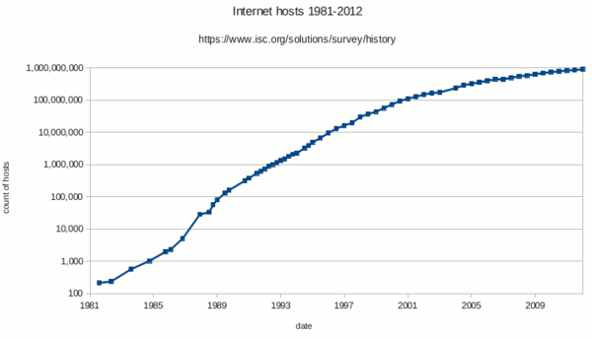
Internet Hosts, 1981-2012

Slide 4
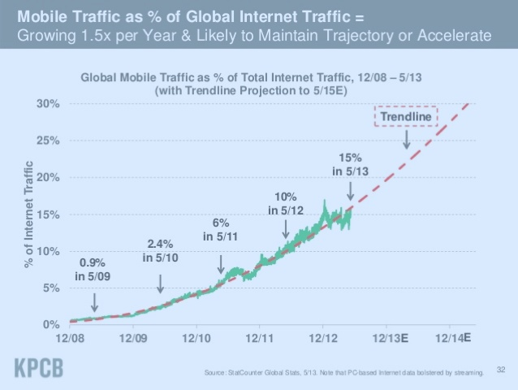
Wired vs. Wireless Access

Slide 5
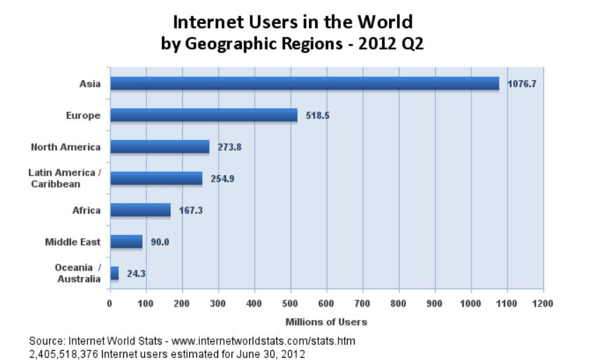
Internet Users by Region

Slide 6
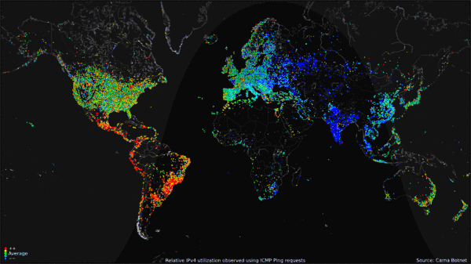
World Map of Usage over a 24 Hour Period in 2012: Red is High

Slide 7
What has changed?
Faster and cheaper communications that are increasingly global in scope
Much lower barriers to forming groups, especially groups that connect geographically dispersed people and institutions
New forms of collaboration, e.g. crowd-sourcing and crowd-funding; new forms of surveillance
The migration of many human activities that used to occur only in the physical world to “Cyberspace”

Slide 8
Blurring of Regulatory Boundaries
Boundaries between previously separate regulatory spaces are blurring
Examples:
Telephone networks vs. data networks
Print media vs. online media
Face to face vs. distance education
New infrastructures must be built to accommodate increasing demand for high-speed (broadband) services

Slide 9
Big Players vs. Little Players
Big Players: Google, Baidu, eBay, Ali Baba, Facebook, Twitter, Weibo, Apple, Amazon
Big Internet Service Providers (ISPs): AT&T, Verizon, Comcast, BT, France Telecom, etc.
Little firms (often innovative and often absorbed by the big players): e.g. Whatsapp, Snapchat, Instagram, YouTube, Oculus, etc.
Even smaller firms that can remain independent if sufficiently nimble

Slide 10
Policies that Effect Innovation (for example)
Antitrust, competition law enforcement
Net neutrality, colocation, access to the local loop
Subsidies for building out infrastructure
R&D and other science-related policies
Intellectual property rights regimes
Digital standards
Privacy rules and regulations

Slide 11
Transatlantic Issues
Dominance of US-owned firms in important markets
Tax havens (e.g. Ireland)
Rise of pirate parties
Variance in competition and intellectual property laws and enforcement practices
Other varieties of capitalism issues

